Slide 1
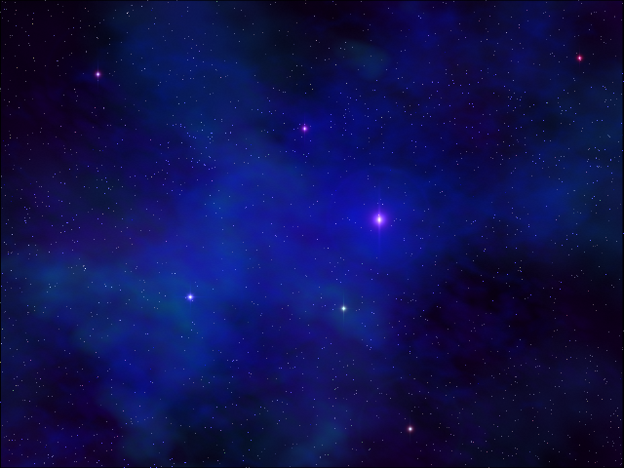
TWX: Legacies
Plot by Asaf Hamtzany
AKA ‘UAF’

Slide 2
Main page
Intro
Prolog
The New Arm
Back Home
New Dangers
The REAL threat
Ending Movie
Race descriptions
Extras
Credits

Slide 3
The New Arm
The salvation fly between the arms on autopilot, eventually stopping in a uninhabited system at the new arm. The player don’t have enough fuel to return.
The player start exploring the place, meeting the new arm races, and the quests of the new arm.

Slide 4
The New Arm Adventures
The Main theme of this part of the game is The Mrn Threat which lead him to the SC2 area – Back Home.
During this time the player also get to know the races of the new arm, and can begin some of the quests involving them.

Slide 5
The New Arm Races
Okk’ara
Khar
Mokopo
Denrode
Estion
Kterbi
Alkory
Niko
Ger
Mmrnmhrm
AI
Mrii
Melnorme
Manglers

Slide 6
Back Home
State of the Home Quadrant
New races in the Old Arm:
  Guph
  Jyglar
Back Home Adventures

Slide 7
Back Home Adventures
The first quest the player encounter back home, a mandatory quest to finish before the player can go back to the New Arm, is the Framed quest.
Hays will suggest that finding more about the Mrn history and creators might help. The player find this in the Story of the Mrn quest (Under new dangers adventures)
The second quest available at this part is Getting Talana, however it doesn’t have to be completed at this part of the game.
The player can also Find Fwiffo now.

Slide 8
New Dangers
If the player returns to the new arm, he’ll find that several races converted to the Niko religion (thus are under Niko control) in order to escape Mrn attacks – and it works.
The Okk’ara, Mokopo, Khar and AI are now under the control of the Niko’s “church”.
The player must learn more about the Mrn and the reasons to their behavior, and “convert” the races back.
Also, at this point the player can find the MK2

Slide 9
As the player get to the New Arm, Wu’bi will hold him to his part of the bargain – Wu’bi will disappear for two months, then return without saying where he was and what he did.
A big change in the game appears now, as the Melnorme space gate in the SC2 area is completed, and it’s now easy and fast to travel between the arms.
Races from the both arms start exploring using the gate – like the Estion who begin scavenging the remains of the races in the Kohr-ah path, and the Druuge who search for new trade opportunities in the new arm.

Slide 10
New Dangers - adventures
Finding the MK2
Khar
Story of the Mrn
AI
Okk’ara
Mokopo
Kterbi

Slide 11
After the player “free” the Mrn and Chmmr, and convince the Khar, Okk’ara and Mokopo to leave the Niko, the AI will betray their Niko allies and leave as well.
The Niko immediately start attacking the AI, but are forced back.
The real threat of the game – the AI, is revealed.

Slide 12
The REAL threat
The AI’s power
Stopping the Mother Ark
Defending against “possession” (Kterbi)
Finding the Precursor factory
Last Battle

Slide 13
Bonus Quests
Saving the Slylandero
The escaping Ur-quan
Quasispace Portal Spawners
Helping the Jyglar
The Supox expedition
The Mangler’s Queen
Finding Fwiffo
The Shofixti HW

Slide 14
Extras
Bonus Quests
The Melnrome Stations
The NAFS Station
Khar Championship
Menacers – monsters of the void
More about the Mrn
The Androsynth survivors
Sites devices and characters in the game
Dates with Talana

Slide 15
Race descriptions
New Arm
Old Arm

